Slide 1
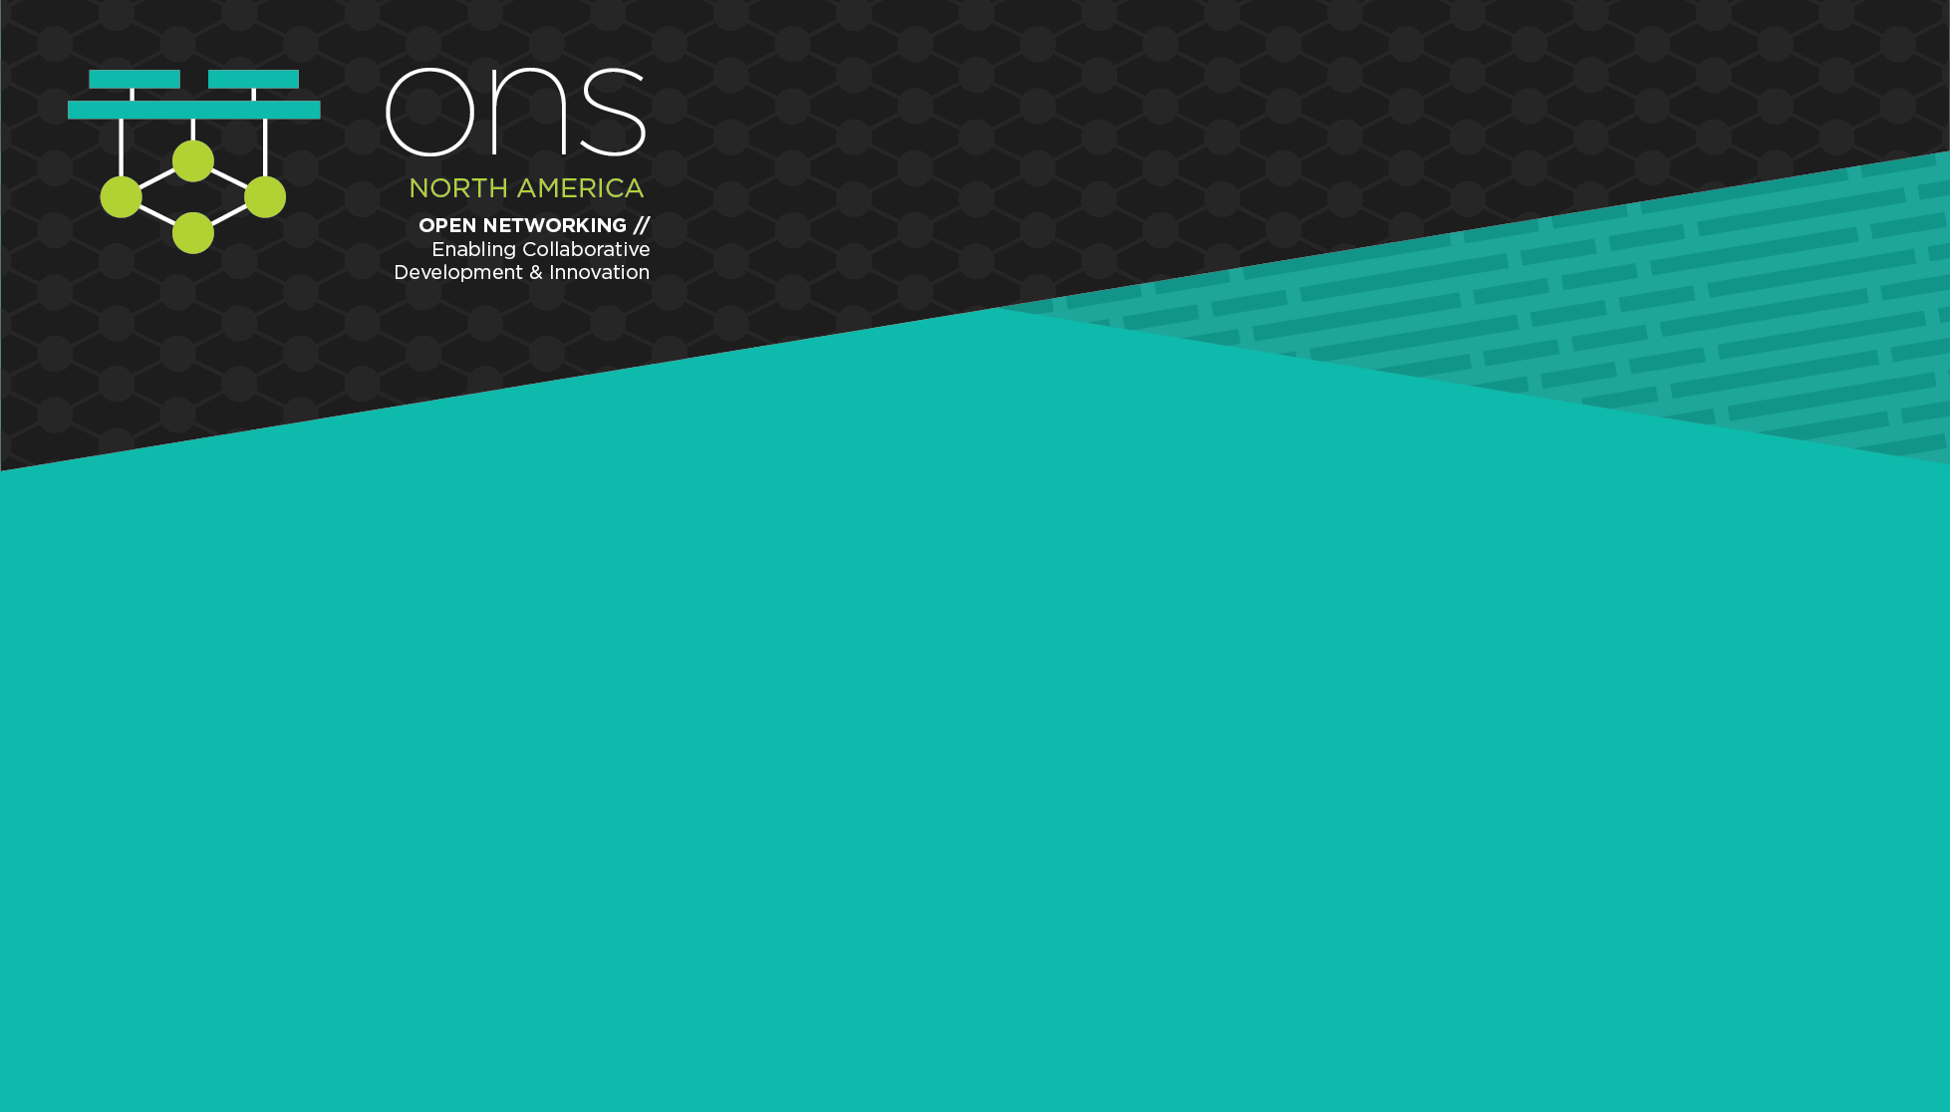
Packet Walk(s) In Kubernetes
Don Jayakody, Big Switch
@techjaya
linkedin.com/in/jayakody

Slide 2
K8S Networking: Basics
root namespace
eth0
Namespaces
Linux kernel has 6 types of namespaces: pid, net, mnt, uts, ipc, user
Network namespaces provide a brand-new network stack for all the processes within the namespace
That includes network interfaces, routing tables and iptables rules
bridge
veth0
veth1
eth0
eth0
namespace-1
namespace-2
Node1

Slide 3
K8S Networking: Basics
Pods
Lowest common denominator in K8S. Pod is comprised of one or more containers along with a “pause” container
Pause container act as the “parent” container for other containers inside the pod. One of it’s primary responsibilities is to bring up the network namespace
Termination of other containers do not result in termination of the namespace

Slide 4
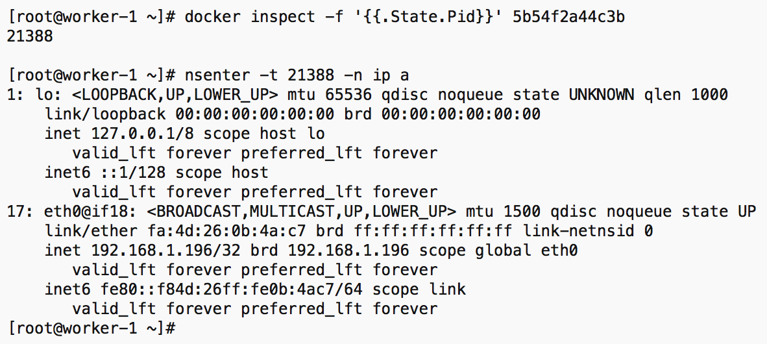

K8S Networking: Basics
Accessing Pod
Namespaces
Multiple ways to access pod namespaces
kubectl exec -it / docker exec -it
nsenter (“namespace enter”, let you run commands that are installed on the host but not on the container)
Both containers belong to the same pod => Same Network Namespace => same ’ip a’ output

Slide 5
K8S Networking: Basics
Container Runtime
Container Networking Interface : CNI
Container Networking Interface
Interface between container runtime and network implementation
Network plugin that implements CNI spec takes a container runtime and configure (attach/detach) it to the network that the plugin implements
CNI plugin is an executable (in: /opt/cni/bin)
When invoked it reads in a JSON config to get all the required parameters to configure the container with the network
CNI Plugin
Configures Networking
Notes:
https://www.slideshare.net/weaveworks/introduction-to-the-container-network-interface-cni

Slide 6
Flannel
K8S
Flannel CNI Plugin
Intro
To make networking easier, Kubernetes does away with port-mapping and assigns a unique IP address to each pod
If a host cannot get an entire subnet to itself things get pretty complicated
Flannel aims to solve this problem by creating an overlay mesh network that provisions a subnet to each server
FlannelD (VXLAN/UDP..)
Network
Notes:
https://blog.laputa.io/kubernetes-flannel-networking-6a1cb1f8ec7c

Slide 7

Flannel
6
7
5
8
root
eth0
4
root
eth0
9
Packet Flow
flannel0
flannel0
Flannel0 device does VXLAN encap/decap
Traffic from pod1 is going through “flannel0” device before exiting
2
cbr0
3
cbr0
10
11
veth0
veth1
veth0
veth1
1
12
eth0
eth1
eth0
eth1
pod1
pod2
pod3
pod4
Node1
Node2

Slide 8
Calico
Felix
Bird
The primary Calico agent that runs on each machine that hosts endpoints.
Responsible for programming routes and ACLs, and anything else required on the host
BGP Client: responsible of route distribution
When Felix inserts routes into the Linux kernel FIB, Bird will pick them up and distribute them to the other nodes in the deployment

Slide 9
Calico
Architecture
Felix's primary responsibility is to program the host's iptables and routes to provide the connectivity you want to and from the pods on that host.
Bird is a BGP agent for Linux that is used to exchange routing information between the hosts. The routes that are programmed by Felix are picked up by bird and distributed among the cluster hosts
eth0
Bird
eth0
Bird
iptables
route table
iptables
route table
flannel0
flannel0
cbr0
Felix
cbr0
Felix
veth1
veth1
eth0
eth1
eth0
eth1
pod1
pod2
pod3
pod4
Node1
Node2
*etcd/confd components are not shown for clarity

Slide 10
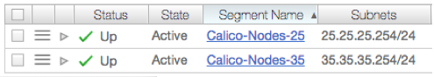
Calico
Topology
root
bond0
root
bond0
Node IP belongs to 2 different subnets: 25.25.25.0/24 & 35.35.35.0/24
Gateway is configured with .254 in the network for each network segment
Bond0 interface is created by bonding two 10G interfaces
iptables
iptables
tunl0
tunl0
route table
route table
Node-121
25.25.25.121
Node-122
35.35.35.122

Slide 11
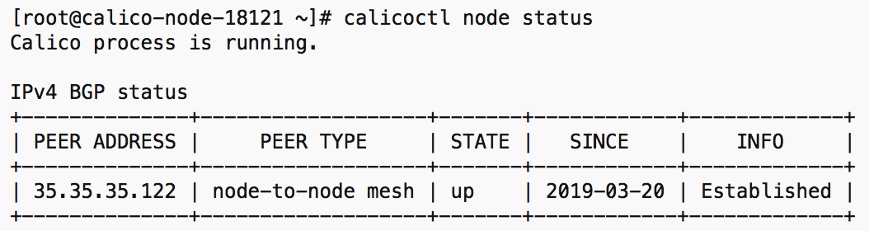
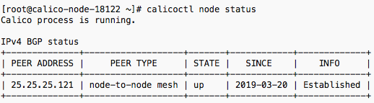
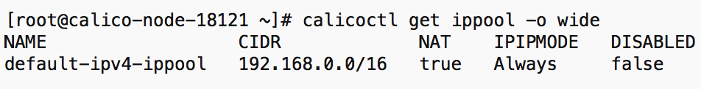
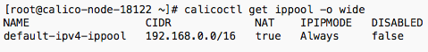
Calico
Default Configuration
root
bond0
root
bond0
iptables
iptables
tunl0
tunl0
route table
route table
Node-to-node mesh
IP-IP encapsulation
Node-121
25.25.25.121
Node-122
35.35.35.122

Slide 12
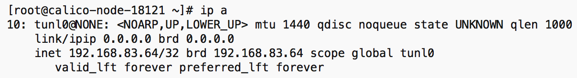
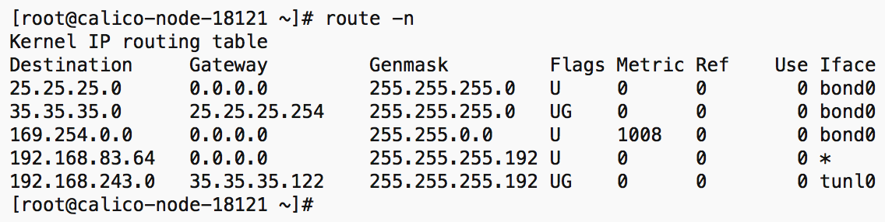
Calico
“ipip” tunnel
Default Configuration
root
bond0
root
bond0
iptables
tunl0
192.168.83.64
iptables
tunl0
route table
route table
Default: Node Mesh with IP-IP tunnel
Route table has entries to all the other tunl0 interfaces through other node IPs
Route to the other node’s tunnel
Node-121
25.25.25.121
Node-122
35.35.35.122

Slide 13
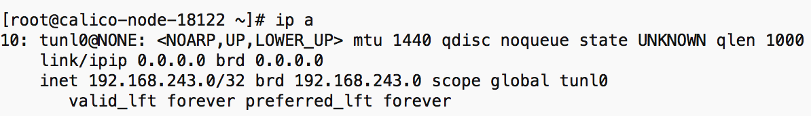
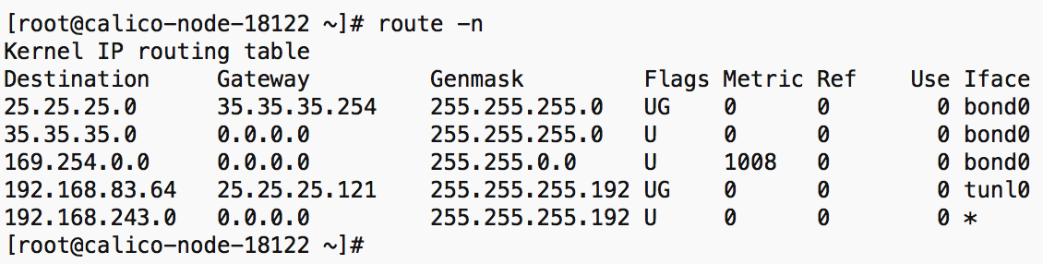
Calico
“ipip” tunnel
Default Configuration
root
bond0
root
bond0
iptables
iptables
tunl0
192.168.243.0
tunl0
Route to the other node’s tunnel
route table
route table
Default: Node Mesh with IP-IP tunnel
Route table has entries to all the other tunl0 interfaces through other node IPs
Node-121
25.25.25.121
Node-122
35.35.35.122

Slide 14
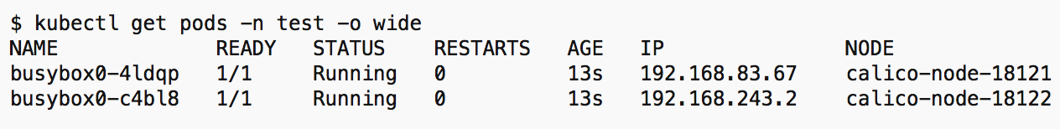
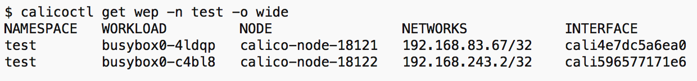
Calico
veth interfaces
Pod-to-Pod Communication
root
bond0
root
bond0
iptables
tunl0
192.168.83.64
iptables
tunl0
192.168.243.0
route table
route table
Brought up 2 pods
“calicoctl get wep” (”workloadendpoints”) shows the endpoints in calico end
cali-x
cali-y
pod1
eth0
pod2
eth0
192.168.83.67
192.168.243.2
Node-121
25.25.25.121
Node-122
35.35.35.122

Slide 15
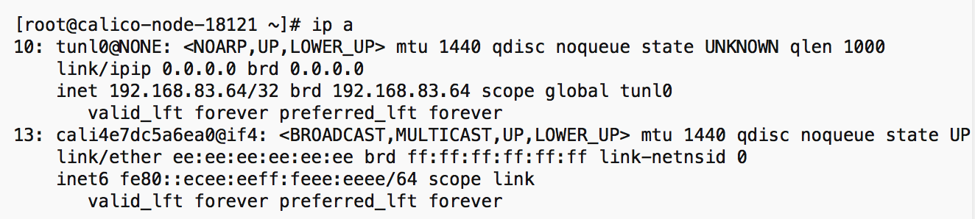
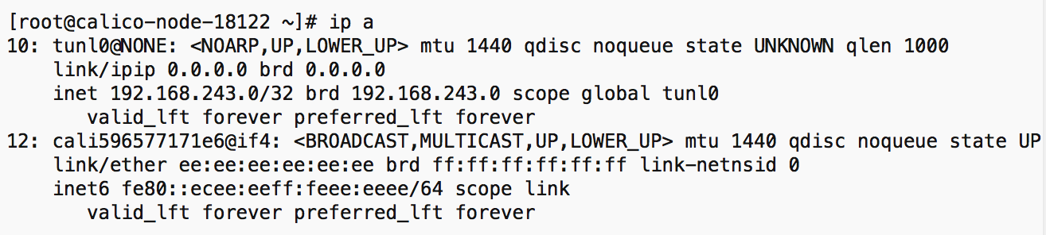
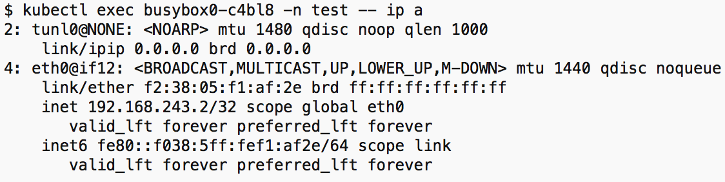
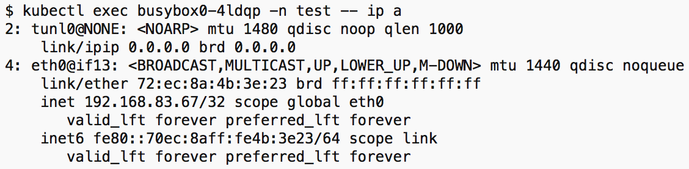
Calico
notice the index on veth.
eg: “eth0@if13” on pod1 ns corresponds to 13th interface on the root ns
Pod-to-Pod Communication
root
bond0
root
bond0
iptables
tunl0
192.168.83.64
iptables
tunl0
192.168.243.0
route table
route table
VETH Interface with “cali-xxx” got created on the root namespace
Other end is attached to the pod namespace
cali-x
cali-y
pod1
eth0
pod2
eth0
192.168.83.67
192.168.243.2
Node-121
25.25.25.121
Node-122
35.35.35.122

Slide 16
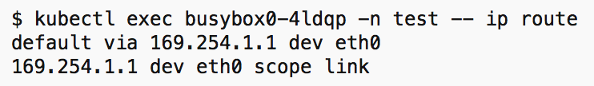
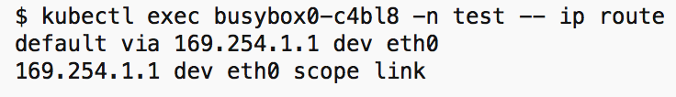
Calico
root
bond0
root
bond0
ARP Resolution
iptables
tunl0
192.168.83.64
iptables
tunl0
192.168.243.0
route table
route table
How does ARP gets resolved?
pod1 & pod2 default route is pointing to private IPv4 “169.254.1.1”
cali-x
cali-y
pod1
eth0
pod2
eth0
192.168.83.67
192.168.243.2
Node-121
25.25.25.121
Node-122
35.35.35.122

Slide 17
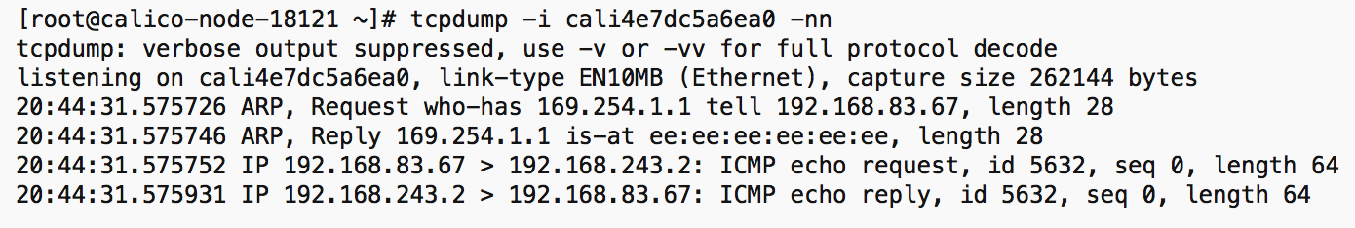
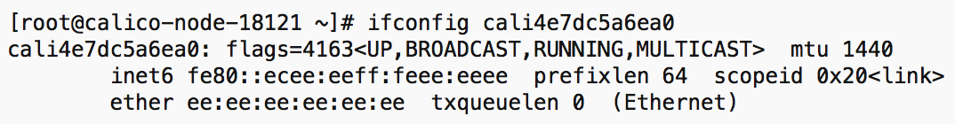
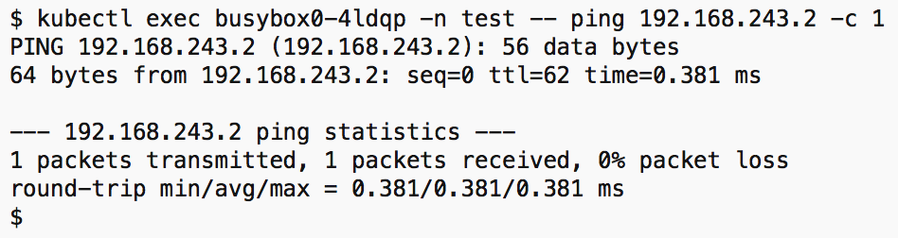
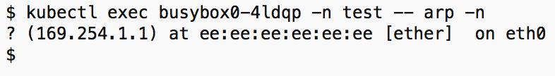
Calico
2
tcpdump on root veth
3
root veth is replying with its own MAC
root
bond0
1
root
bond0
ARP Resolution
Pinging the pod2 from pod1
iptables
tunl0
192.168.83.64
iptables
tunl0
192.168.243.0
route table
route table
Initiate ping from pod1-to pod2
ARP request is send to default GW 169.254.1.1
cali interface replies to ARP request with it’s own MAC
cali-x
cali-y
pod1
eth0
pod2
eth0
192.168.83.67
192.168.243.2
Node-121
25.25.25.121
Node-122
35.35.35.122

Slide 18
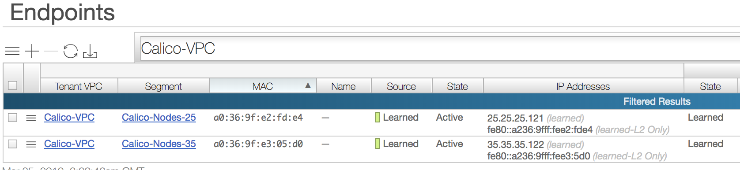
Calico
No pod-MAC/IPs will be learned on the network. Only Node-IPs
root
bond0
root
bond0
ARP Resolution
iptables
tunl0
192.168.83.64
iptables
tunl0
192.168.243.0
route table
route table
Why “Cali-” VETH Interfaces replies to the ARP request?
Reason: Proxy-ARP is enabled on the veth interface on root namespace
Network is only learning the Node IP/MACs, not pod macs
Proxy ARP is enabled on Cali veth:
cali-x
cali-y
pod1
eth0
pod2
eth0
192.168.83.67
192.168.243.2
Node-121
25.25.25.121
Node-122
35.35.35.122

Slide 19
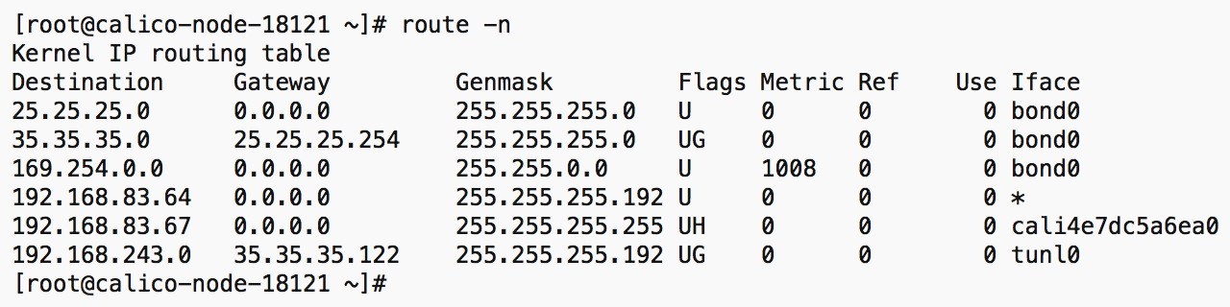
Calico
Notice the 2 IP headers: IP-IP protocl
Once the ARP is resolved, routing table rules kicks in
Packet Forwarding
root
bond0
root
bond0
iptables
tunl0
192.168.83.64
iptables
tunl0
192.168.243.0
route table
route table
After ARP Resolution packet gets forwarded according to the routing table entries
Packets will get encapsulated via IP-IP
cali-x
cali-y
pod1
eth0
pod2
eth0
192.168.83.67
192.168.243.2
Node-121
25.25.25.121
Node-122
35.35.35.122

Slide 20
Calico
5
6
4
7
Packet Forwarding
root
bond0
3
root
bond0
8
iptables
tunl0
192.168.83.64
iptables
tunl0
192.168.243.0
route table
route table
After ARP Resolution packet gets forwarded according to the routing table entries
Packets will get encapsulated via IP-IP
cali-x
2
cali-y
9
1
10
pod1
eth0
pod2
eth0
192.168.83.67
192.168.243.2
Node-121
25.25.25.121
Node-122
35.35.35.122

Slide 21
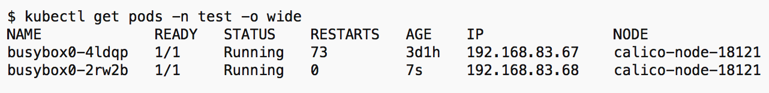
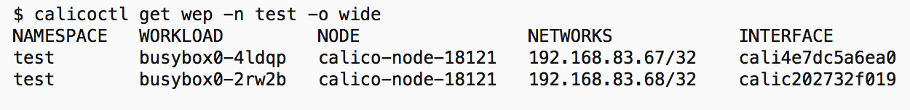
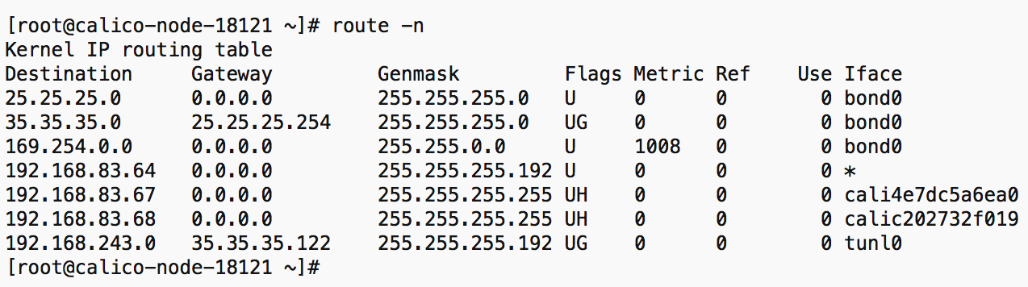
Calico
Packet Forwarding in the same host
root
bond0
root
bond0
iptables
tunl0
192.168.83.64
iptables
tunl0
192.168.243.0
route table
route table
/32 routes are present in the routing table for all the containers
Packets get forwarded to the appropriate calico veth interface based on the routing rules
cali-x
2
cali-z
cali-y
1
3
pod1
eth0
eth0
pod3
eth0
pod2
eth0
192.168.83.67
192.168.83.68
192.168.243.2
Node-121
25.25.25.121
Node-122
35.35.35.122

Slide 22
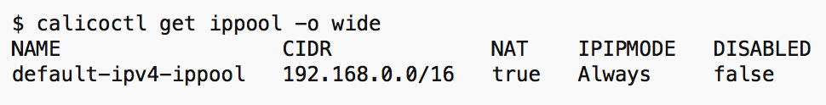
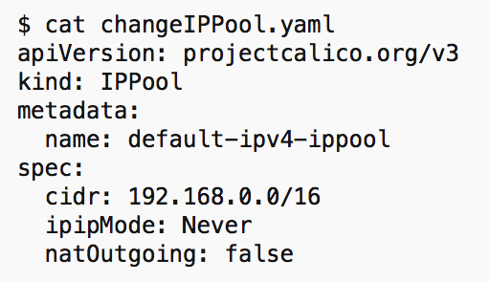
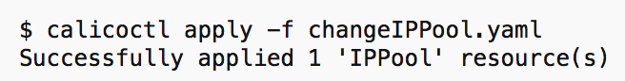
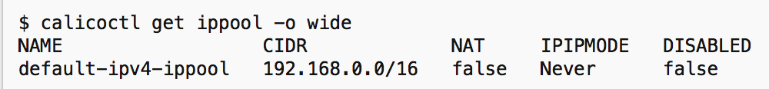
Calico
root
bond0
root
bond0
Non IP-IP
iptables
iptables
tunl0
tunl0
route table
route table
Disable IP-IP Mode
Node-121
25.25.25.121
Node-122
35.35.35.122

Slide 23
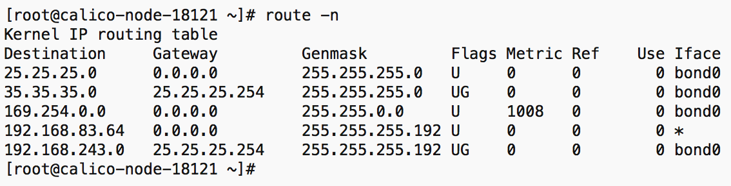
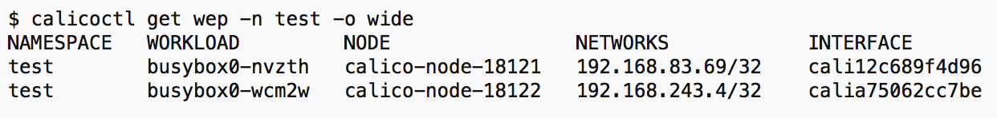
No more tunl0. Pod routes are directly pointing to bond0
Calico
root
bond0
root
bond0
Non IP-IP
iptables
iptables
❌
❌
tunl0
tunl0
route table
route table
Disable IP-IP Mode. tunl0 interface is not present anymore
Routes are pointing to the bond0 interface
Bring up 2 pods as before
cali-x
cali-y
pod1
eth0
pod2
eth0
192.168.83.69
192.168.243.4
Node-121
25.25.25.121
Node-122
35.35.35.122

Slide 24
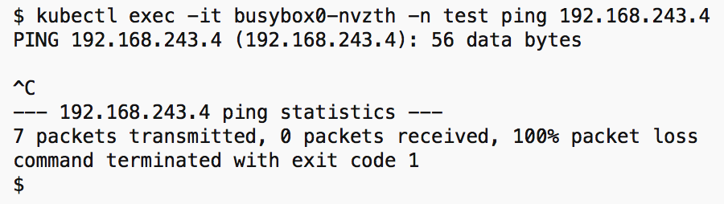
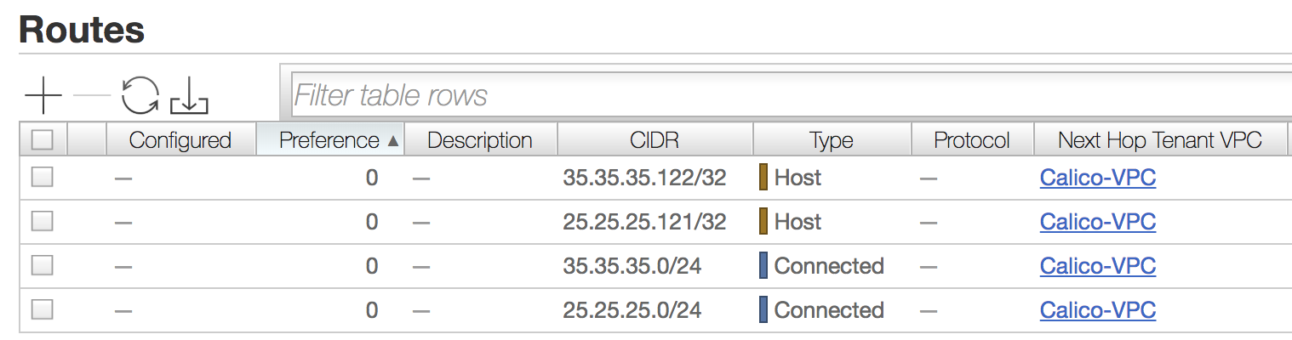
Calico
Packets won’t go.
Reason: No routes to the pod networks
3
❓
root
bond0
root
bond0
Non IP-IP
iptables
iptables
❌
❌
2
tunl0
tunl0
route table
route table
Ping from pod1 to pod2 is unsuccessful
Reason: Routes are not advertised to the Network
cali-x
cali-y
1
pod1
eth0
pod2
eth0
192.168.83.69
192.168.243.4
Node-121
25.25.25.121
Node-122
35.35.35.122

Slide 25
Calico
Bird
Bird
root
bond0
root
bond0
BGP mode
iptables
iptables
❌
❌
tunl0
tunl0
route table
route table
Need the Calico nodes to peer with the network fabric
cali-x
cali-y
pod1
eth0
pod2
eth0
192.168.83.69
192.168.243.4
Node-121
25.25.25.121
Node-122
35.35.35.122

Slide 26
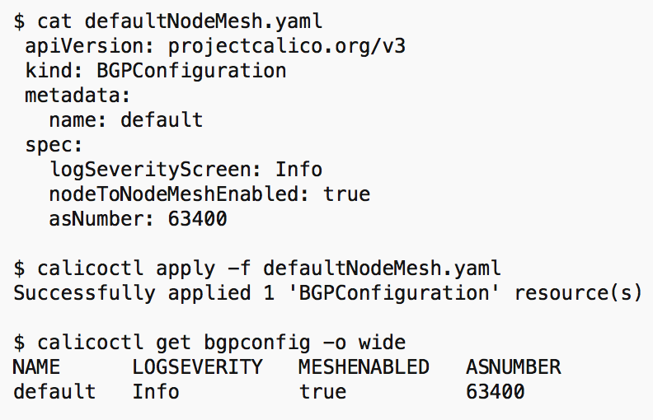
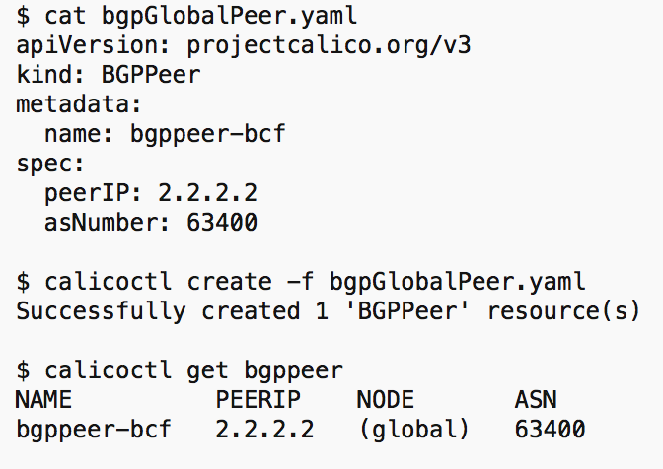
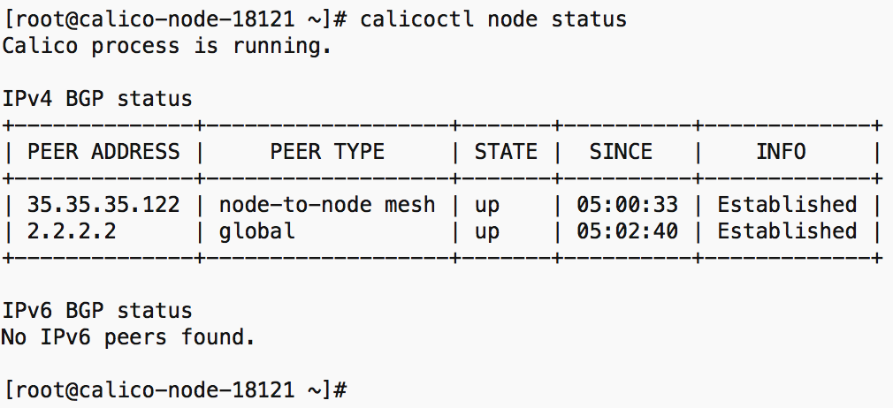
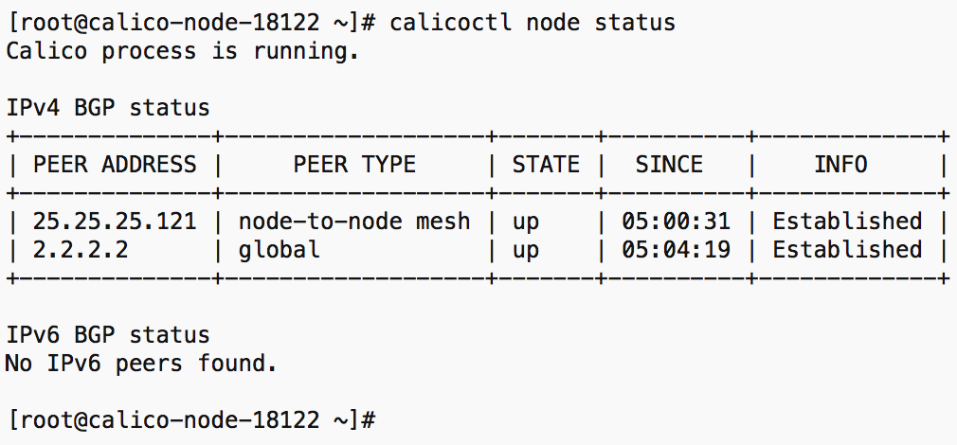
Calico
Create a BGP configuration with AS:63400
Create a ”global” BGP Peer
root
bond0
root
bond0
BGP Mode
iptables
iptables
❌
❌
tunl0
tunl0
route table
route table
Create a global BGP configuration
Create the network as a BGP Peer (**Assuming an abstracted cloud network. Config will vary depending on vendor)
cali-x
cali-y
pod1
eth0
pod2
eth0
192.168.83.69
192.168.243.4
Node-121
25.25.25.121
Node-122
35.35.35.122
Both Nodes are peering with the global BPG Peer

Slide 27
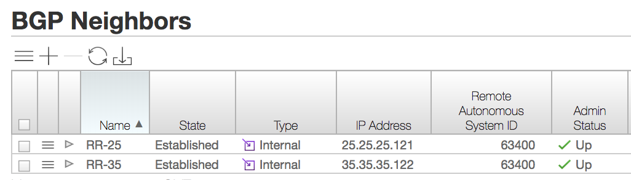
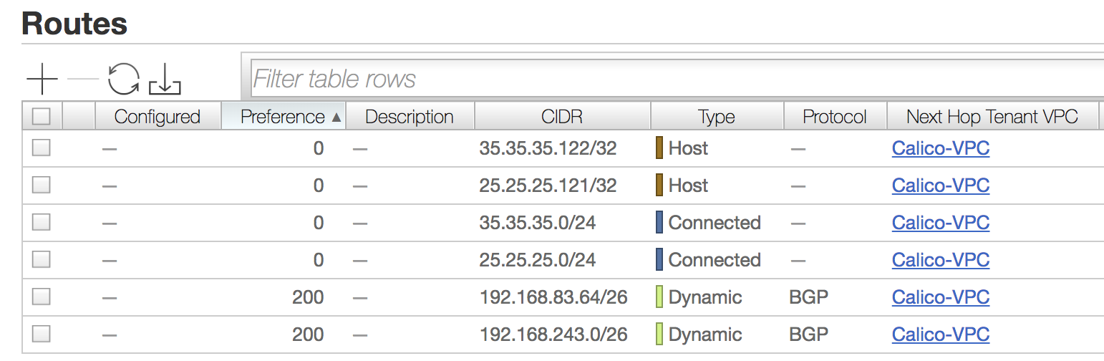
Calico
Network is peering with both the Calico Nodes
root
bond0
root
bond0
BGP Mode
iptables
iptables
❌
❌
tunl0
tunl0
route table
route table
Configure the Calico nodes as BGP Neighbors on the network
As a result network will get to learn about 192.168.83.64/26 & 192.168.243.0/26 routes
cali-x
cali-y
Network is learning pod network routes via BGP
pod1
eth0
pod2
eth0
192.168.83.69
192.168.243.4
Node-121
25.25.25.121
Node-122
35.35.35.122

Slide 28
Calico
5
4
3
6
root
bond0
root
bond0
BGP Mode
iptables
iptables
2
7
route table
route table
Packets goes across the network without any encapsulations
cali-x
cali-y
1
8
pod1
eth0
pod2
eth0
192.168.83.69
192.168.243.4
Node-121
25.25.25.121
Node-122
35.35.35.122

Slide 29
Cilium
Architecture
eth0
Cilium
Agent
Cilium Agent, Cilium CLI Client, CNI Plugin will be running on every node
Cilium agent compiles BPF programs and make the kernel runs these programs at key points in the network stack to have visibility and control over all network traffic in/out of all containers
flannel0
cbr0
veth1
BPF Program
BPF Program
eth0
eth1
pod1
pod2
Node1
*etcd/monitor components are not shown for clarity

Slide 30
Cilium
6
7
5
8
root
eth0
4
root
eth0
9
Packet Flow
cilium_vxlan
cilium_vxlan
cilium_vxlan device does VXLAN encap/decap
Traffic from pod1 is going through “cilium_vxlan” device before exiting
2
cbr0
3
cbr0
10
11
veth0
veth1
veth0
veth1
1
12
eth0
eth1
eth0
eth1
pod1
pod2
pod3
pod4
Node1
Node2

Slide 31
Thanks!
Repo to download all commands/PPT/PDF slides:
https://github.com/jayakody/ons-2019
If you think that’s going to help the community feel free to send pull requests/notes/links to blog posts etc.

